Slide 1
Manchester Raspberry Jam

Slide 2
Manchester Raspberry Jam
“Gosh, that Raspberry Pi thing is cool, isn’t it?”
Jack Kelly

Slide 3
The Raspberry Pi

Slide 4
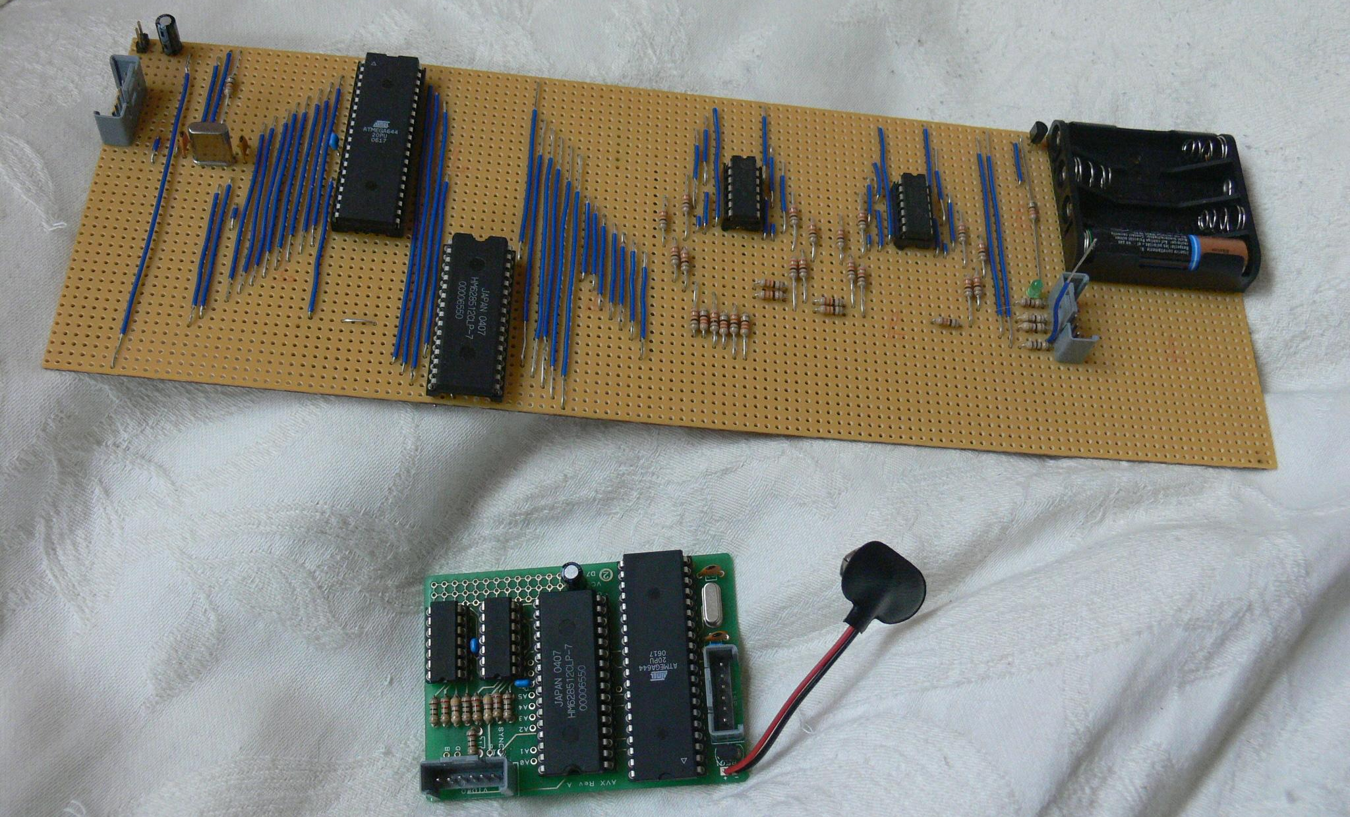
2006

Slide 5

2006

Slide 6
2006
22.1 MHz, 512kB RAM, 320x240 component video

Slide 7
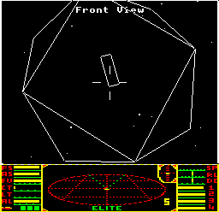
2008

Slide 8
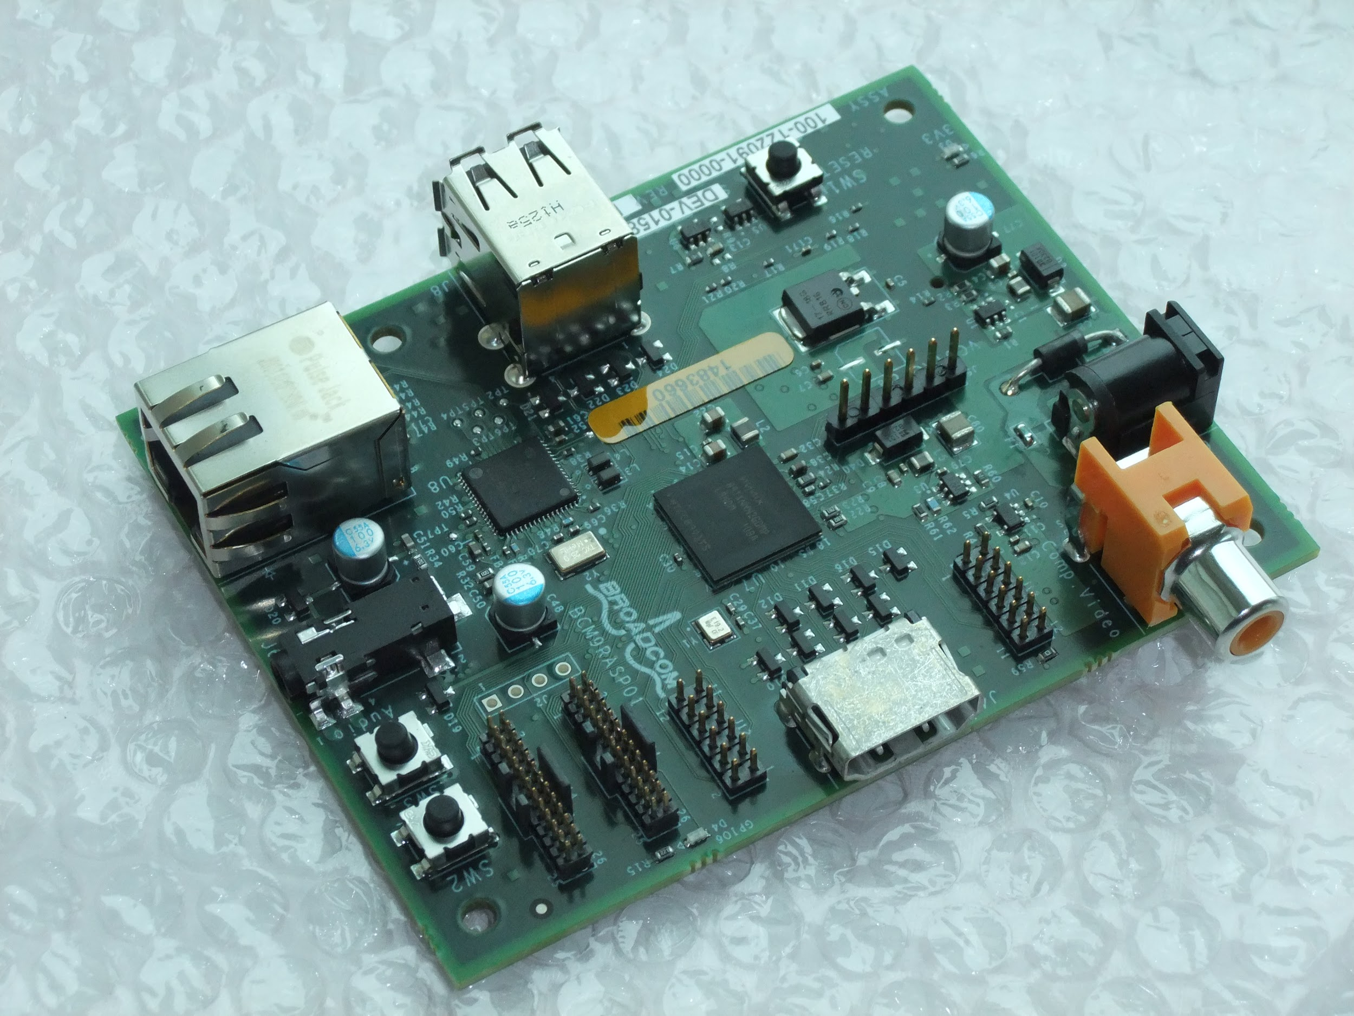
2011

Slide 9
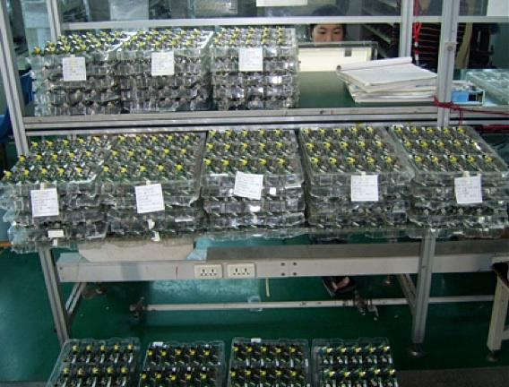
2012

Slide 10
Raspberry Jam

Slide 11
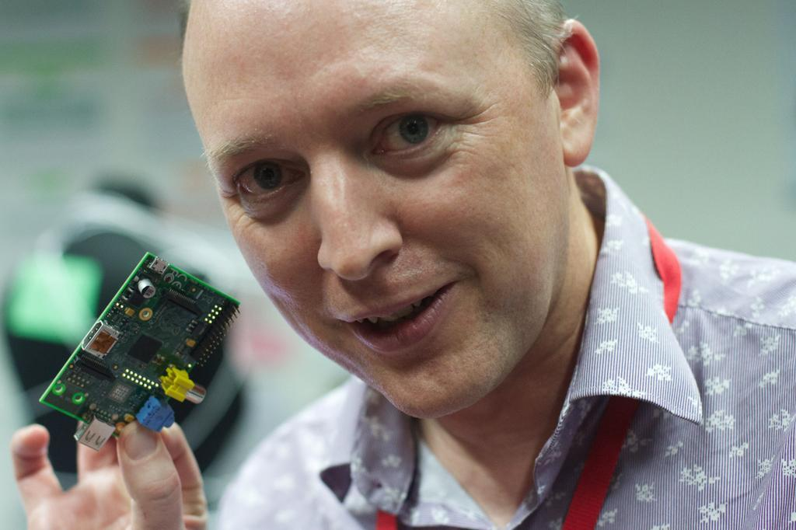
May 2012

Slide 12
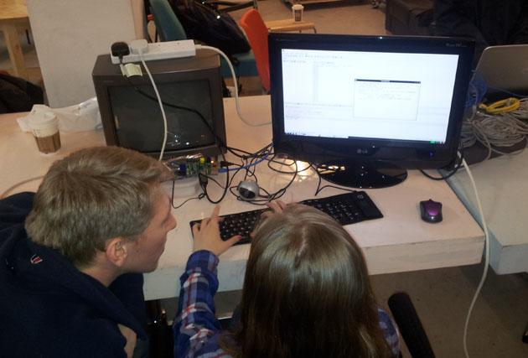
May 2012
9th June

Slide 13
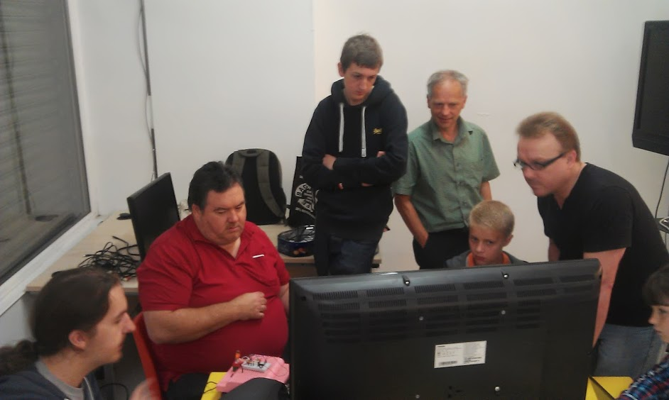
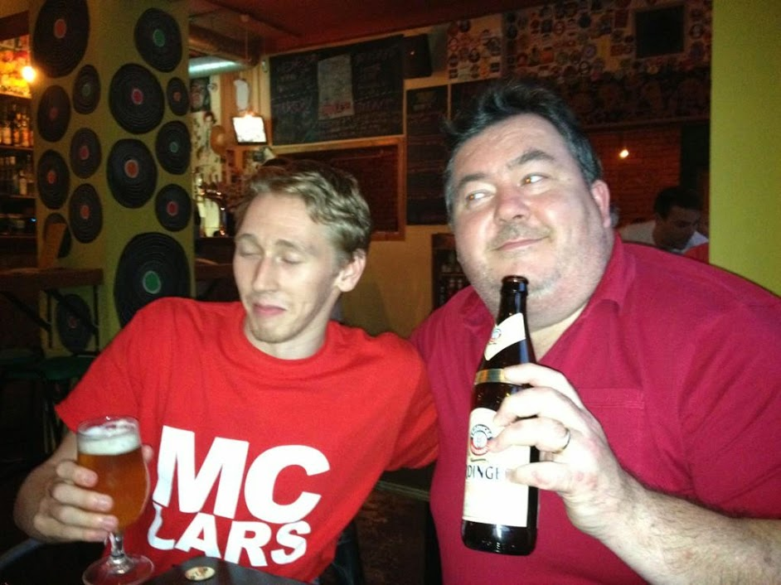
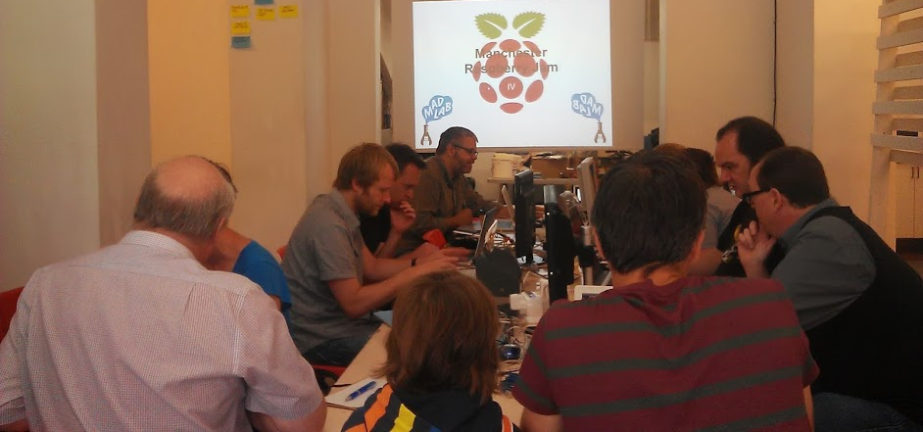
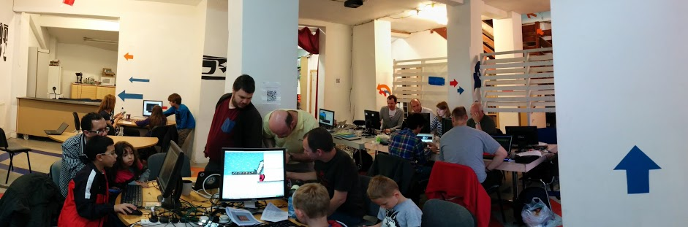

Slide 14
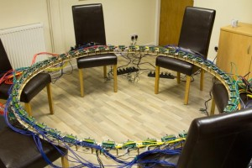
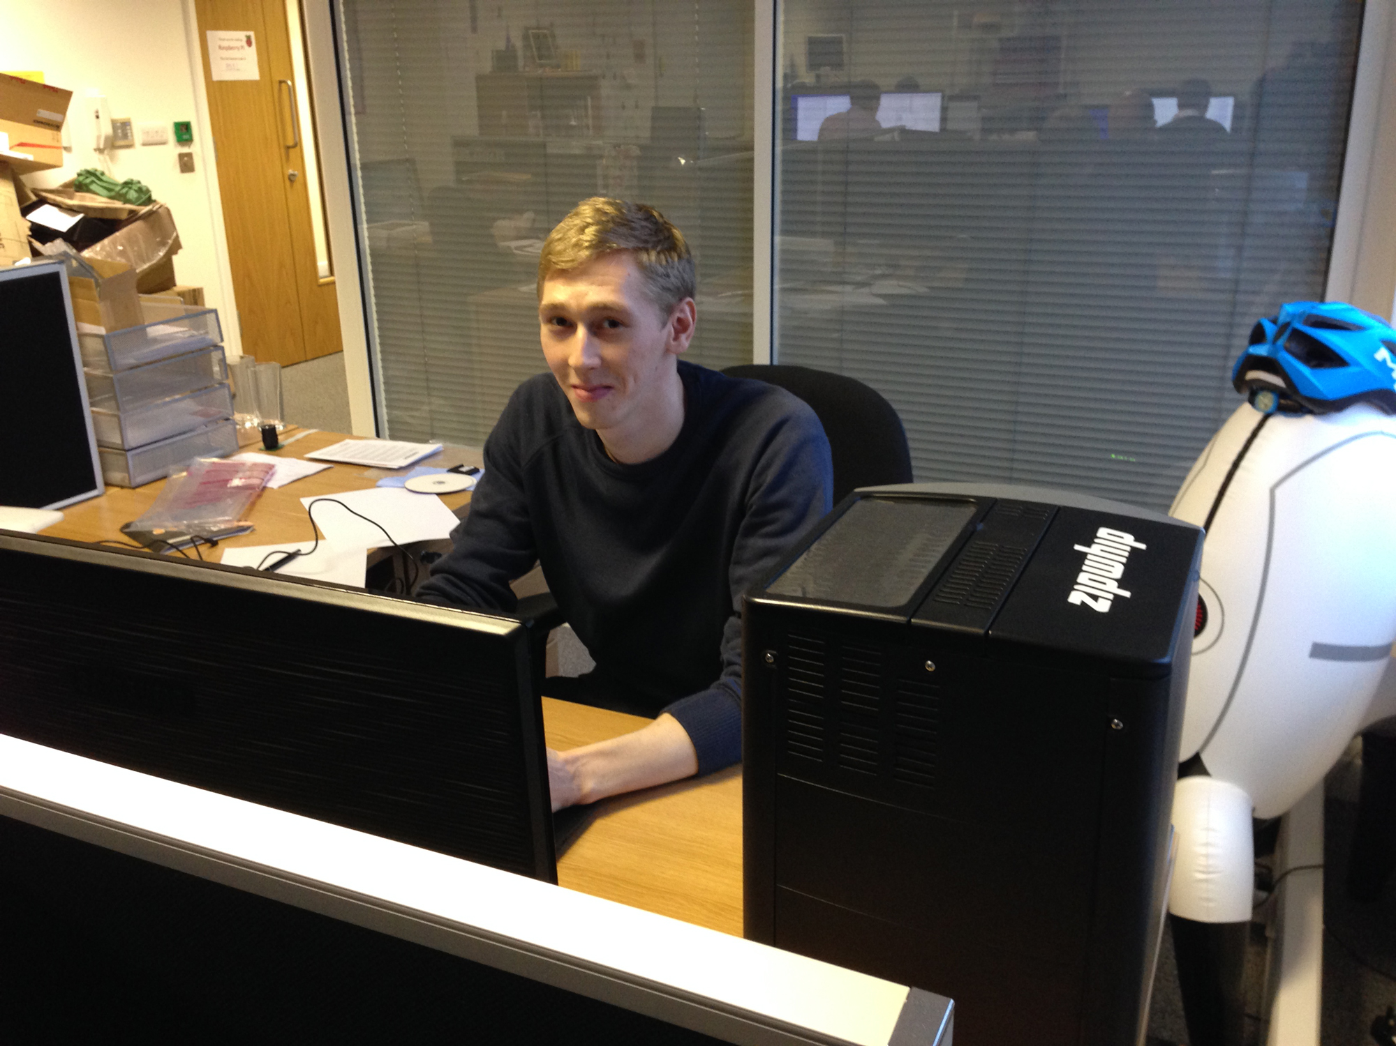
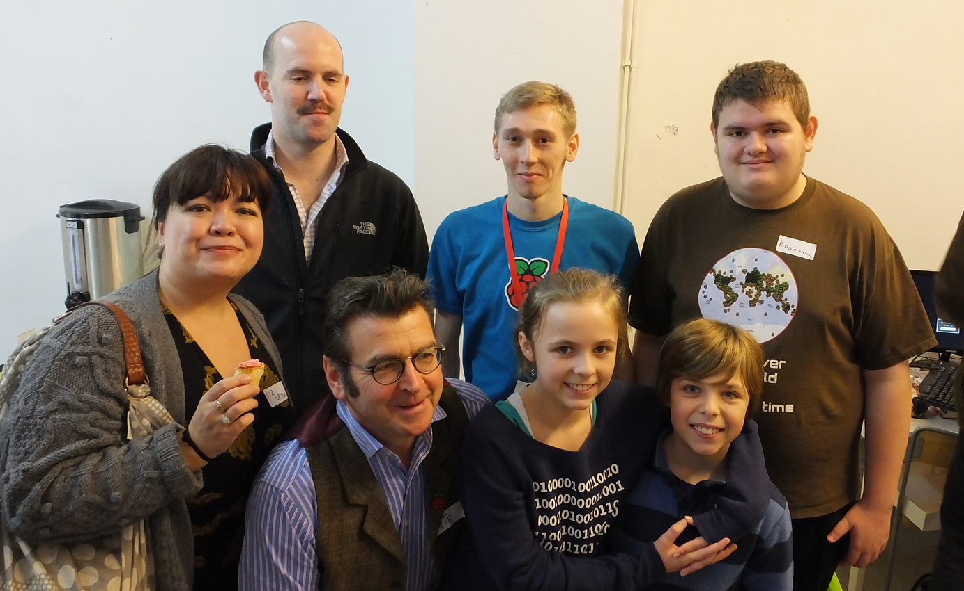
Ben moves to Raspberry Pi

Slide 15
Manchester Jam
(Enough history already)

Slide 16
Manchester Raspberry Jam is a user group
Show projects
Share knowledge
Make things

Slide 17
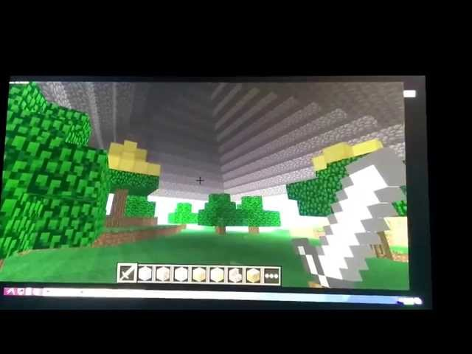

Slide 18
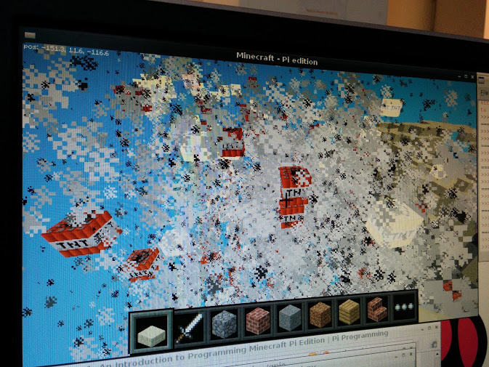

Slide 19
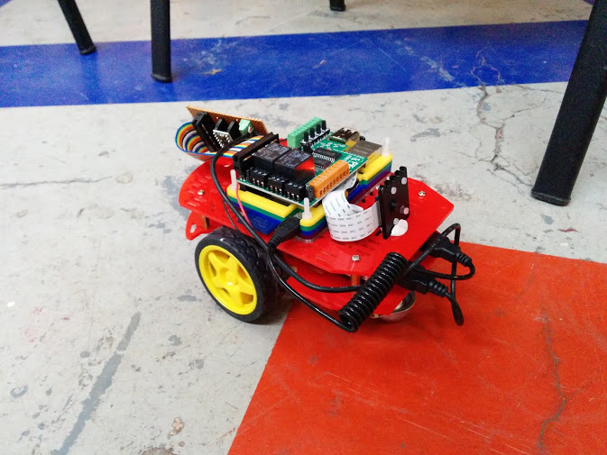

Slide 20
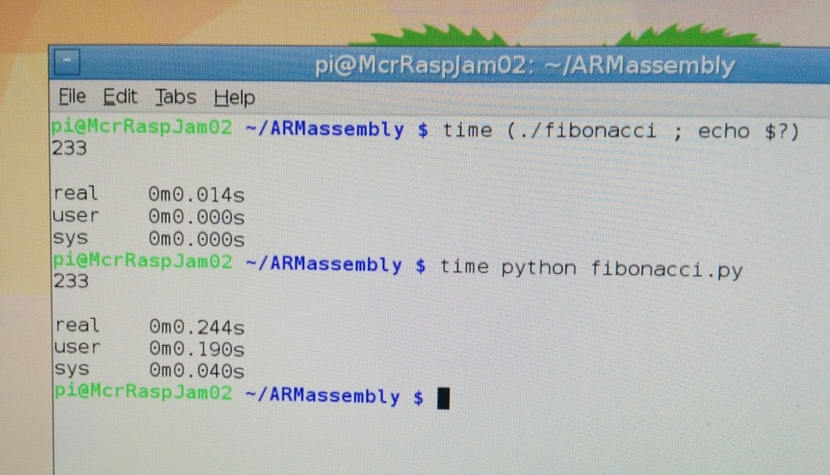

Slide 21
Make things?

Slide 22
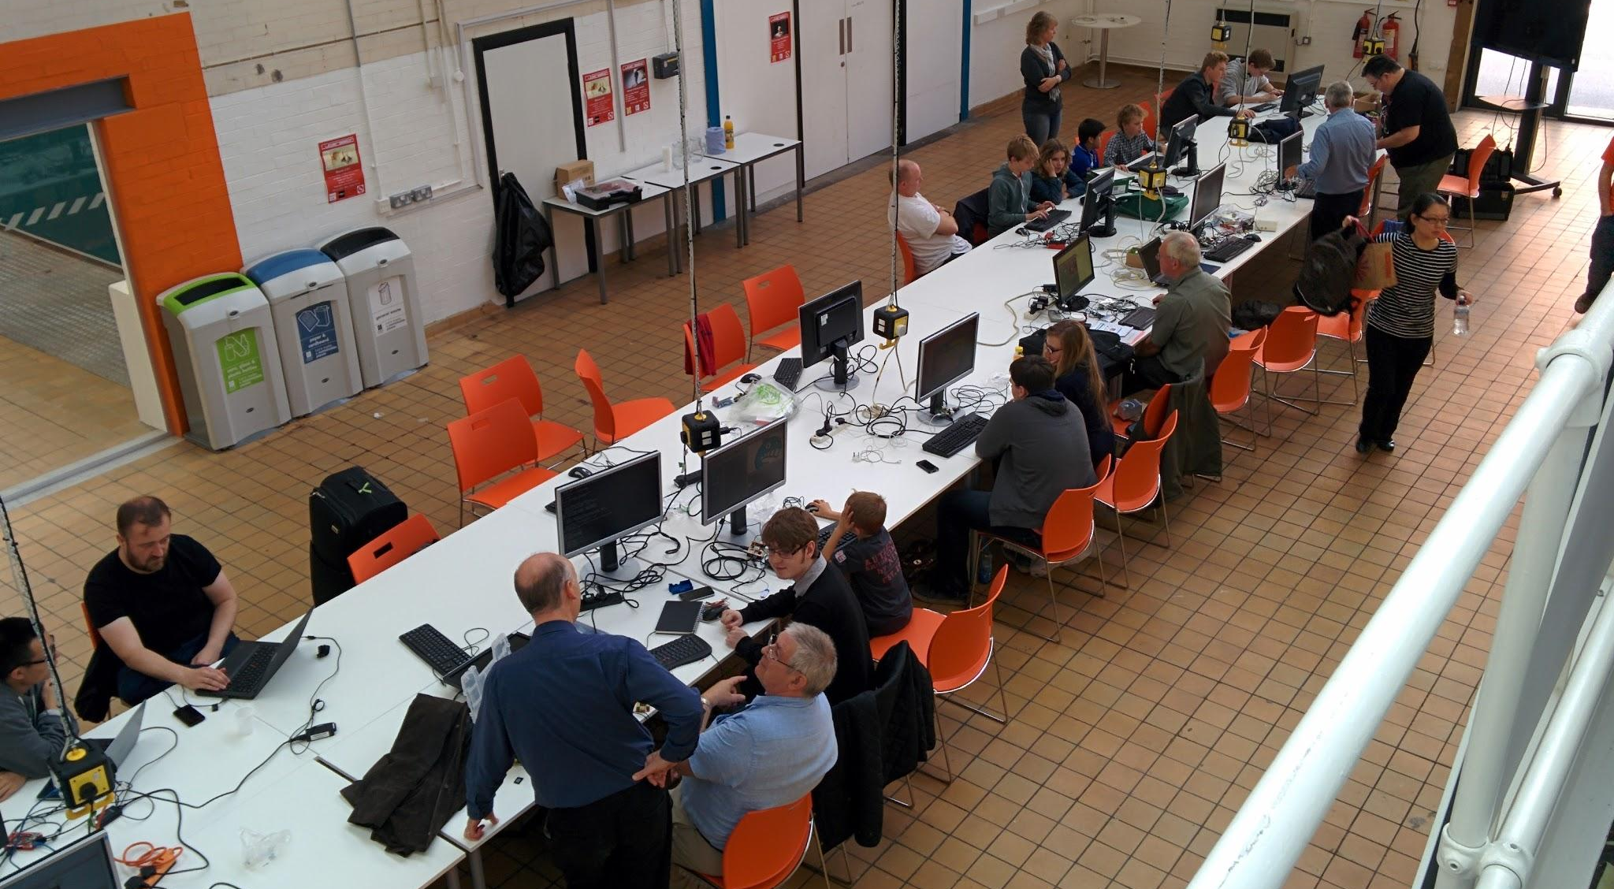
Move to The Shed
It’s cooler than it sounds

Slide 23
Plans for the future
Workshops!
Programming
Soldering
Robots/project in future?

Slide 24
Plans for the future
Get bigger!
Huge space at the shed for 100+ people per event
Extra (mini) Jams?

Slide 25
Come to Manchester Raspberry Jam!
Come along this month…

Slide 26
Come to Manchester Raspberry Jam!
Come along this month…
Because it will be
a lot better in
2-4 months

Slide 27
Come to Manchester Raspberry Jam!
Saturday 8th November
(10am-5pm)
McrRaspJam23.eventbrite.com
McrRaspJam.org.uk
@McrRaspJam

